Slide 1

Cultural Critique Argument Essay
A Basic Overview

Slide 2
Quick Overview: Old and New
What’s Similar to Previous Essays | What’s Different from Previous Essays
We will be doing a lot of analysis of your primary source (movie, book, album, TV show, video game, ???) | We will be adding secondary sources for support and to enter into a conversation with other thinkers
We will still use our analytical skills to answer the question “What message is this sending?” | We will be allowed to make value judgements as we go—the argument is broader, you can say what is good or bad, you can go beyond the primary source
We will be using logic and detailed evidence for support | It will be longer (5 pages minimum)
The essay centers around YOUR argument | You will likely need in-text citations, as we use a variety of sources

Slide 3
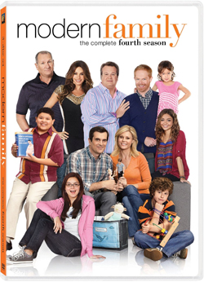

Topic Example: Based on Former Student Essay
A student was interested in writing about the TV show Modern Family; she had watched the show and liked it, but had a sense that it was sending a particular message about gender.
She re-watched a few episodes and took copious notes on dialogue, setting, acting, plot, and even the way the show was shot (camera angles)

Slide 4

Topic Example
The student concluded, based on her details, that the show was sending the message that families worked better if women did not work outside of the home. She realized she thought that was a harmful message to send, and that it went against most people’s ideas about the show being “progressive.”
So she formulated this thesis: “While many think Modern Family celebrates diversity and nontraditional families, it actually sends the regressive message that families function better when women stay home.”

Slide 5


Topic Example
She collected her evidence and created an outline for all of her claims. She wrote about four solid pages of her own analysis of the show, convincing people that it was sending that message, and also including why she felt this was a problem.
Then—and only then—she looked into secondary sources. She found a review of the show that disagreed with her, and used it in an opposing view paragraph. She found another source that wasn’t about Modern Family, but agreed with her about the problems of portraying women as “domestic.” She integrated that as part of her support in the paper.

Slide 6
YOUR TURN!

Slide 7

What Should you Pick?
Something you have likely already seen, read, watched, played, or listened to; we might not have time to read a new book right now, especially if we’re not sure we want to write about it!
Something that is not your “favorite X ever!!” It is difficult to analyze when all we want to do is enjoy
Something that you have immediate access to (especially true in these quarantine times!); you will NEED to take notes and get specific details
Something that is CONTROVERSIAL! This is crucial; don’t pick an inspiration movie and tell us it’s inspirational; don’t pick an informative documentary and tell us it’s informative; go for the less popular opinion whenever possible! This is what made the Modern Family analysis more compelling and interesting (see other examples on assignment sheet)

